Slide 1


CarEye vehicle management system
Shenzhen Shenghong Technology Co., Ltd
major intent

Slide 2

WELCOME
——shenghongTechnology ——
Shenzhen Shenghong Technology Co., Ltd. was established in 2016 to provide mobile device management platform solutions for the public, equipment suppliers and operators, so that they can quickly build their own management system. "Resource sharing and win-win cooperation" is the purpose of our team. The CarEye vehicle management platform developed by the company provides Complete platform interfaces to facilitate the secondary development of third-party developers. The company has been developing from the initial streaming media service to the vehicle management cloud platform, streaming media server, security monitoring platform, video service load balancing, intelligent sanitation and other business fields.
The vehicle management platform base on location and video services has been upgraded repeatedly and can meet the management needs of vehicles in many industries, Truck transportation, environmental sanitation. The company takes video and video service as its main core technology, and its products have been applied to many third-party manufacturer platforms in China.
“
We have dreams
Creating resplendence
about us

Slide 3




Service Items
Provide a complete set of solutions, access vehicles and video equipment for management
Provide video service deployment and provide video services for third-party platforms
Conduct customized development for customers to meet their personalized needs
Provide PAAS service and safely manage vehicles
Open platform
CarEye vehicle management platform provides rich API interfaces to meet customers' secondary development needs, and various components can be easily and quickly applied to third-party platforms in different fields
Open cooperation

Slide 4

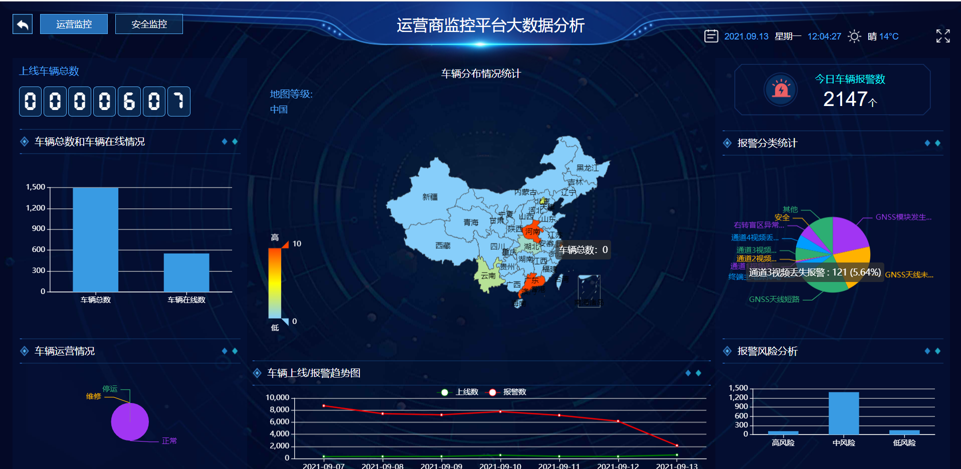
Product features
Product features I
01
02
Product features II
Adopt distributed architecture, front and rear end separation, video service and web separation to meet different customer needs
Accurate sensor algorithm to meet the actual needs of the industry
Product features III
03
04
Product featuresIV
It adopts advanced spring-boot, VUE and other technical architectures with good scalability, and provides BS, CS client and mobile client display
It provides rich APIs to help other ERP systems

Slide 5
Core Technology
01
key technology
06
Advanced technical architecture
Various client displays
The web background uses spring-boot, mysql, Front view adopts VUE technology
Support PC client, mobile client and web client for management and data display
02
05
Streaming media load balancing
Big data analysis
Streaming media services are separated from the web, which is an N: N relationship, that is, multiple web can share a video server, and a web can also call multiple videos to serve it
Data analysis of alarm, position and sensor, assessment of driver, large screen data display
03
04
Active Security Services
Sensor data analysis
The platform supports the Soviet Union standard protocol, can upload active safety evidence and score drivers according to the alarm
Analysis of fuel quantity and load sensor

Slide 6
Platform architecture
Third-party platform
partner
Client
API interface
protocol 809
CarEye
ecology
second develop
payment
ERP Access
Rule
manage
security manage
certificate
authorization
规则管理
alarm
send message
track
data
Exhibition
Business rules
data mining
Data analysis
report
media
manage
media process
storage
data
Model
Driving analysis
Sensor algorithm
balancing
playback
map
manage
economic analysis
backup
restore
track
laction
Message
fence
map
structure
data
Multilingual
user
date
alarm
data
car
manage
OTA
Remote
control
sensor
data
travel
data
data rule
mongodb
Data engine
MySQL
Data source
terminal
car
phone/mobile device

Slide 7
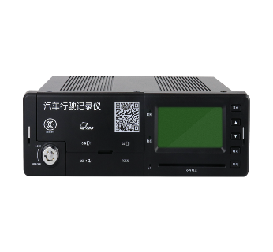
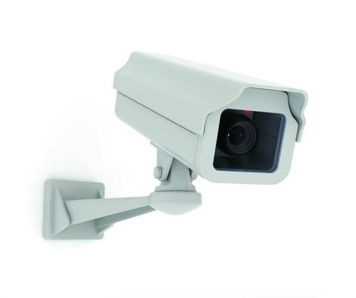
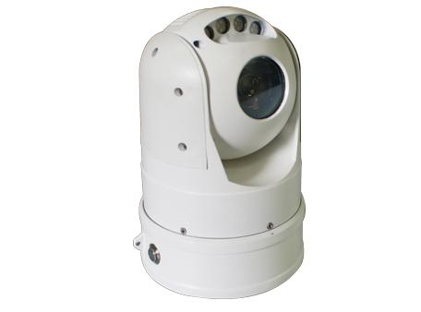

Streaming Media Framework
mediaserve
Vehicle monitoring platform
mediaserve
load balancing
mediaserver
other Mobile device monitoring platform
comm
server
support
GT/T 1078
GB28181
Soft load balancing scheme for multi-device access
open API interface

Slide 8
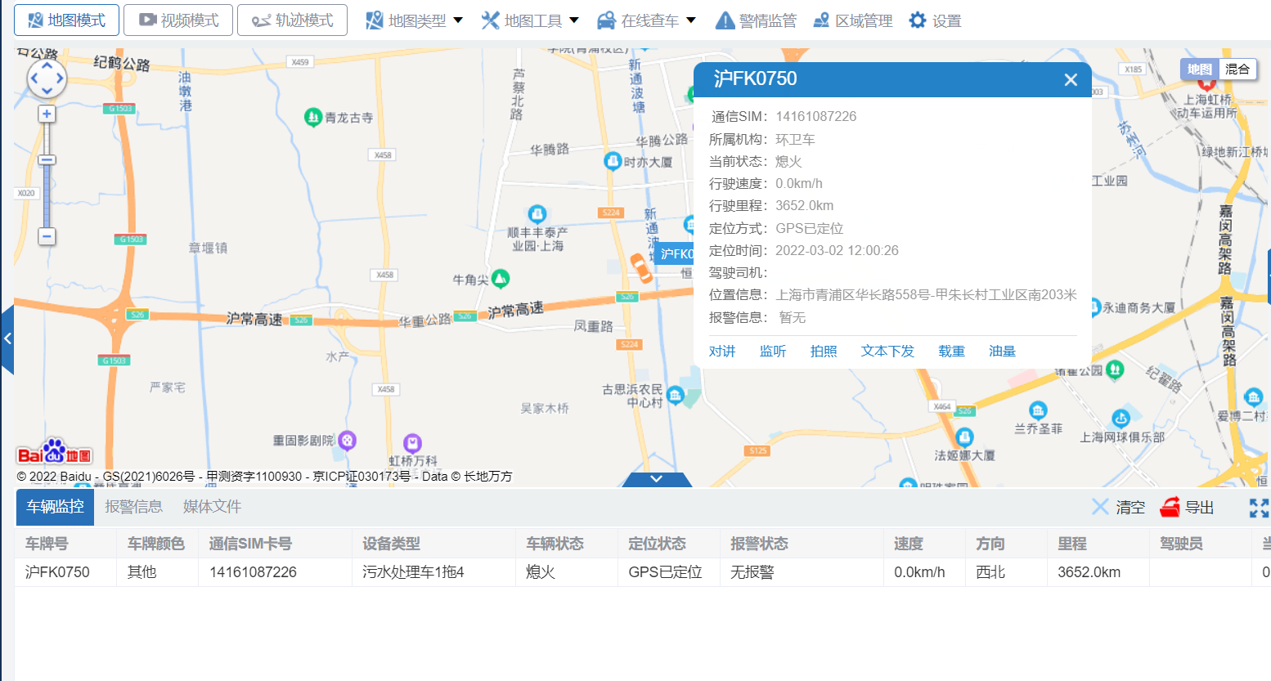
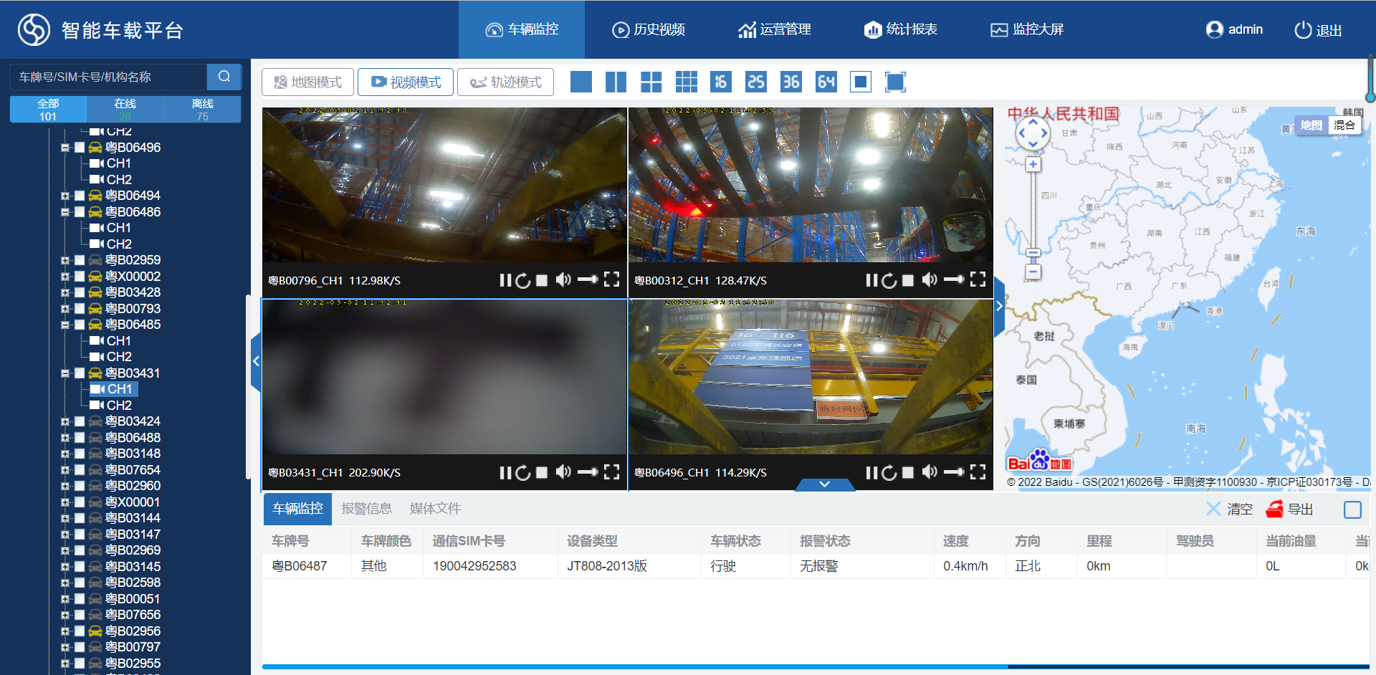
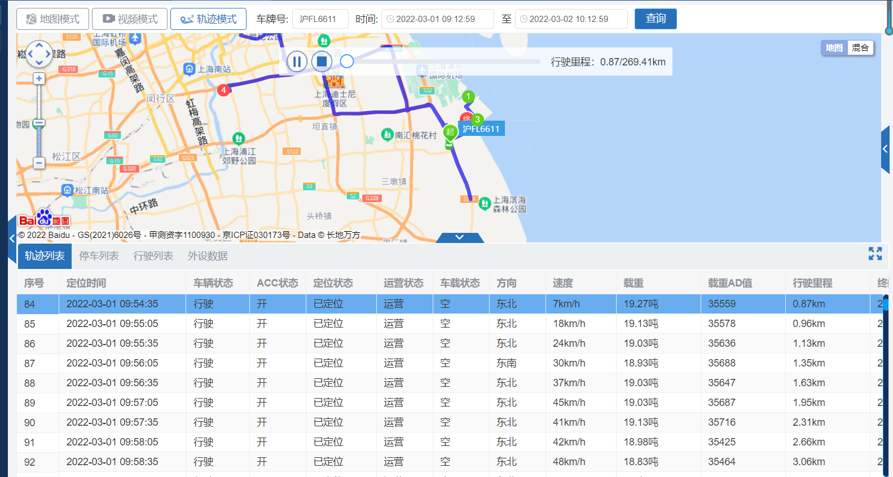
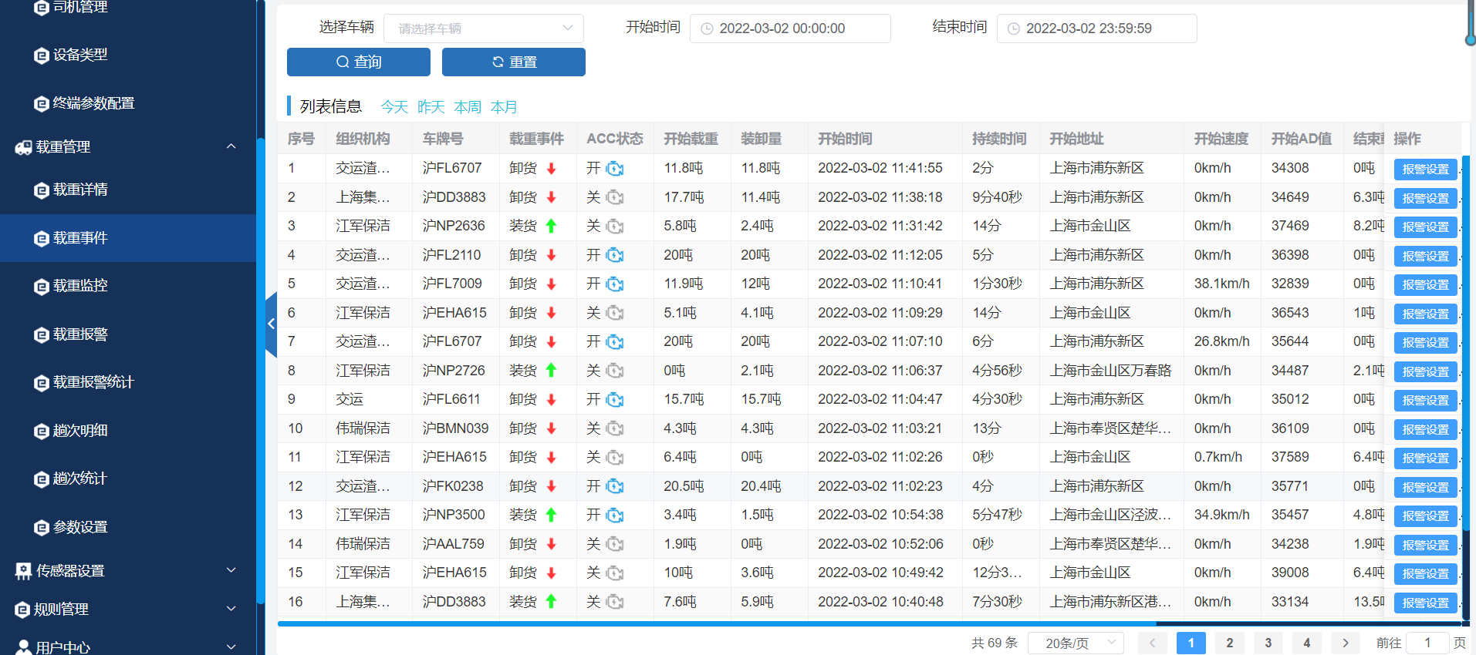
base function
Position monitoring
real-time video
Track playback
operation management

Slide 9
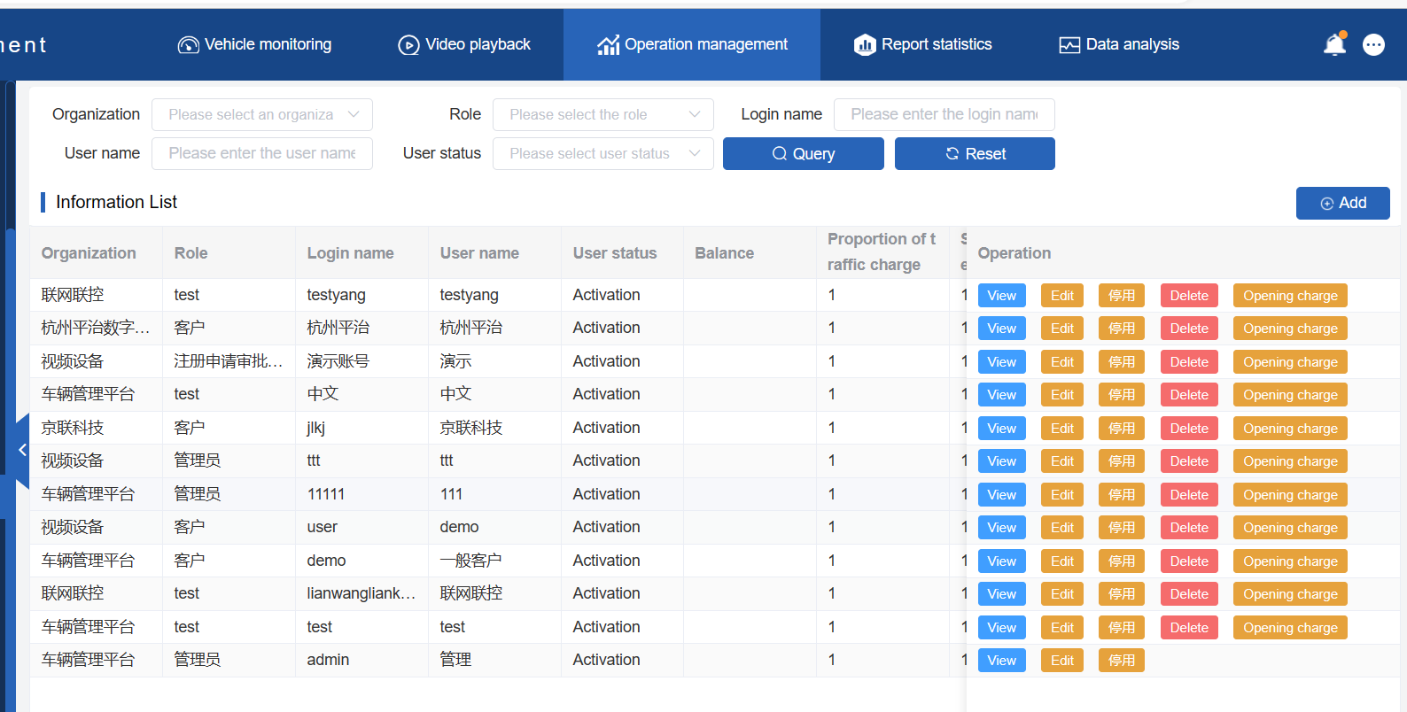
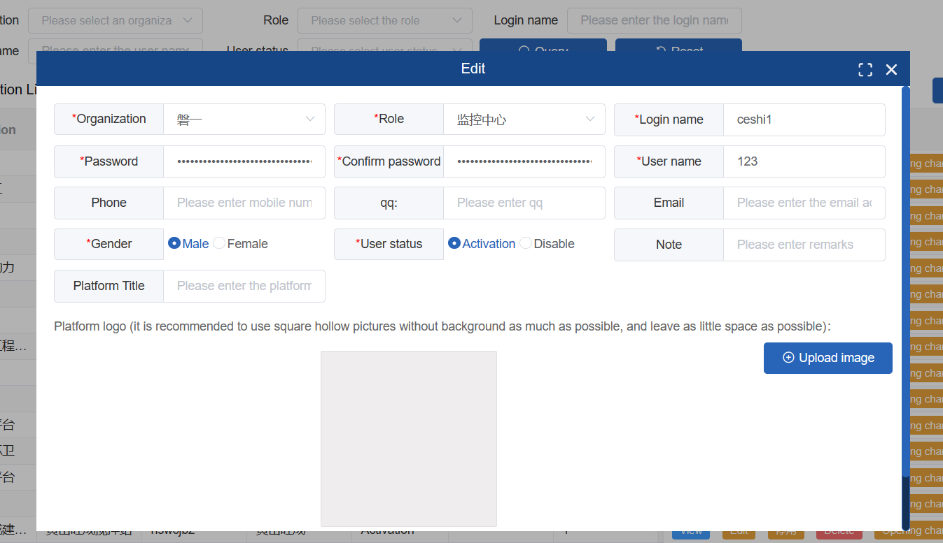
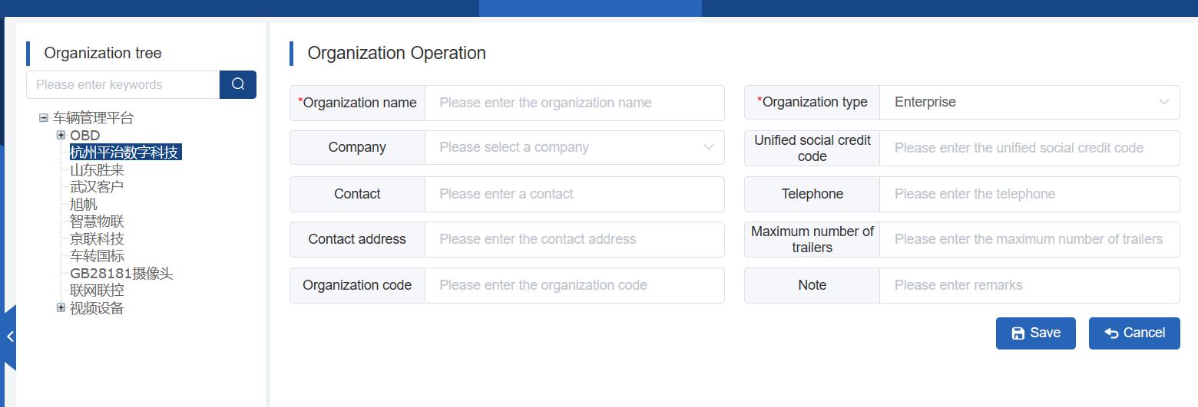
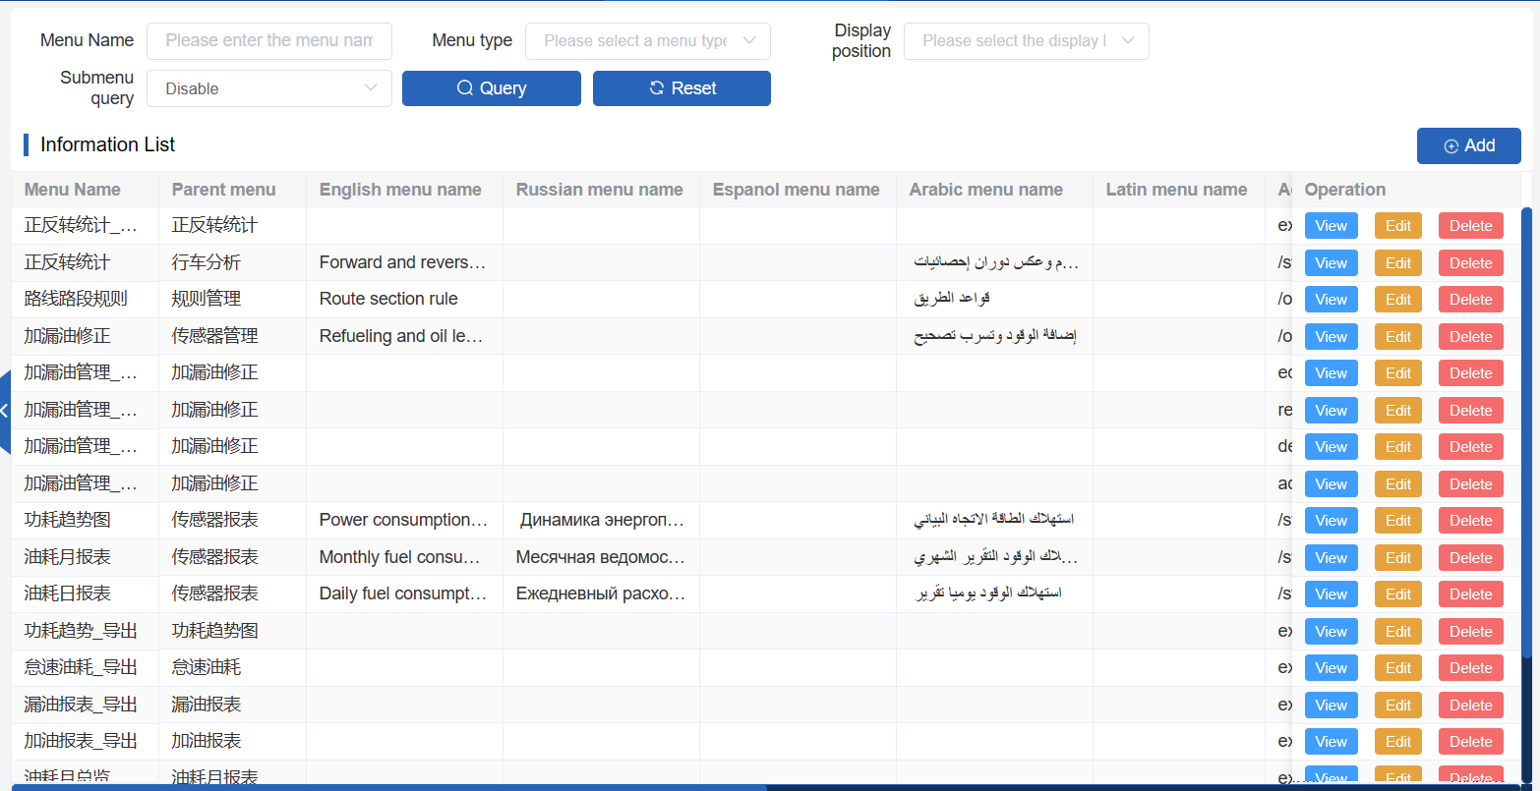
Basic data and permissions
CarEye multi-role, multi-user, multi-agency management. Menu allocation with different permissions, multiple views on one platform, and multiple customers maximize the utilization of resources

Slide 10
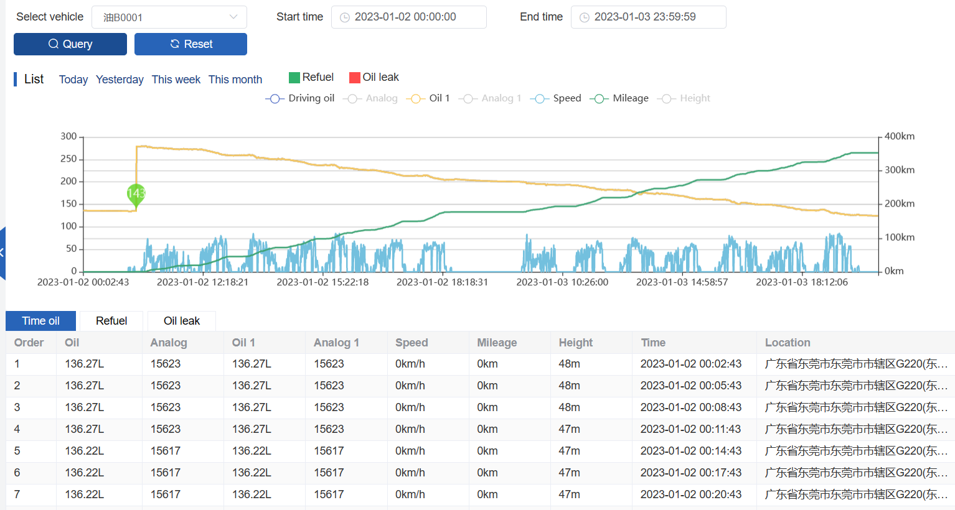
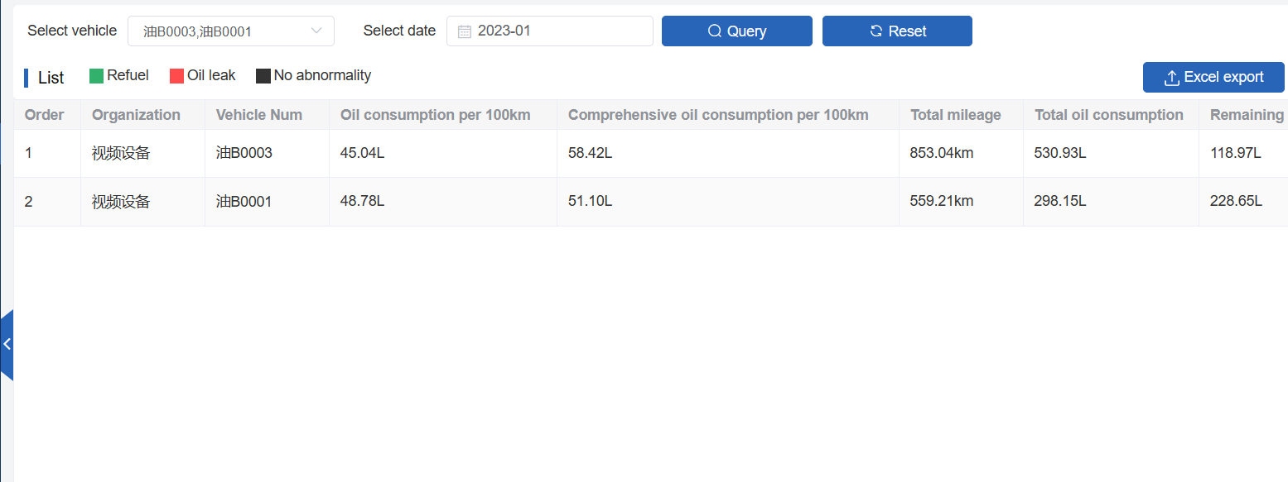
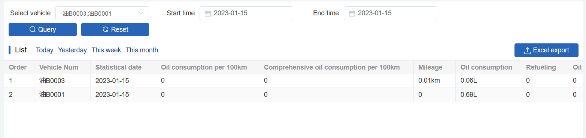
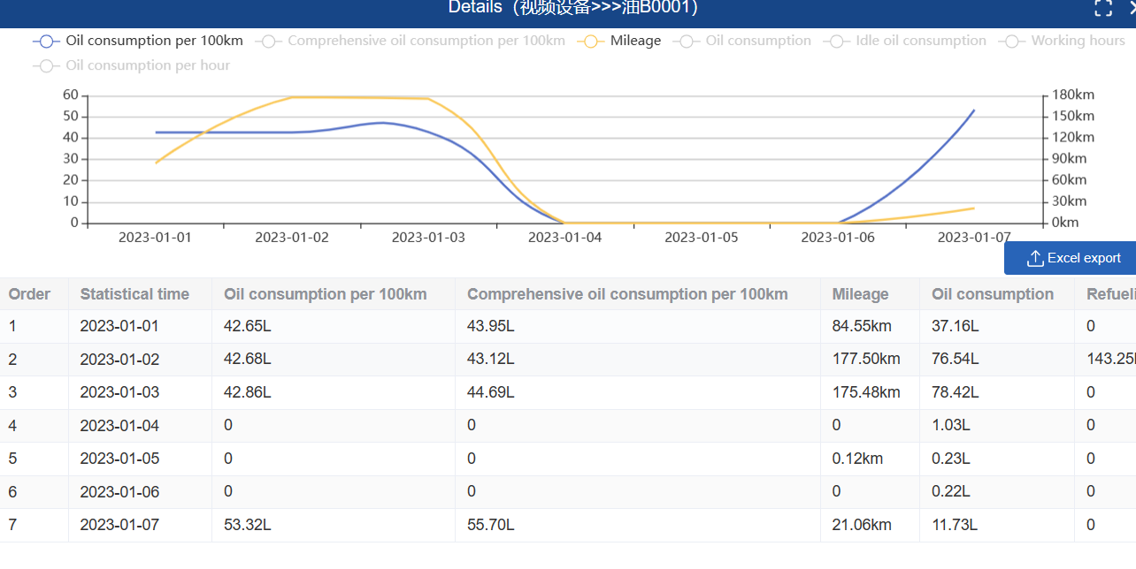
Fuel consumption management
The CarEye platform is connected to the fuel consumption sensor to make statistics on the use of fuel consumption to prevent oil theft and oil leakage. Analyze and compare the energy consumption, find out the vehicles with low energy consumption, and comprehensively master the work efficiency of drivers

Slide 11
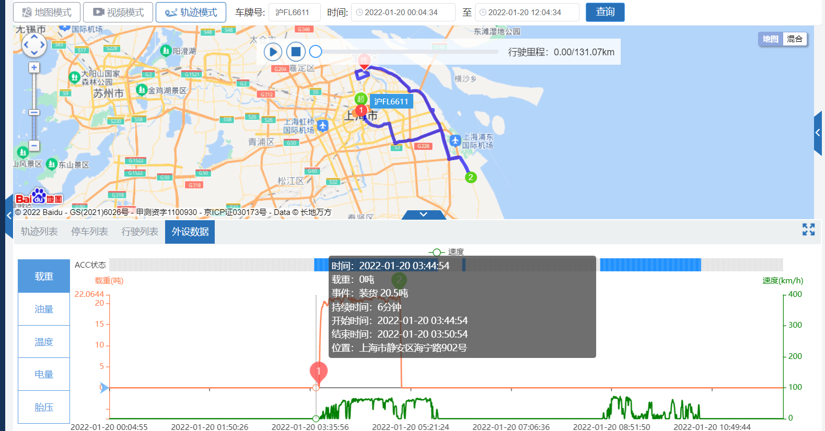
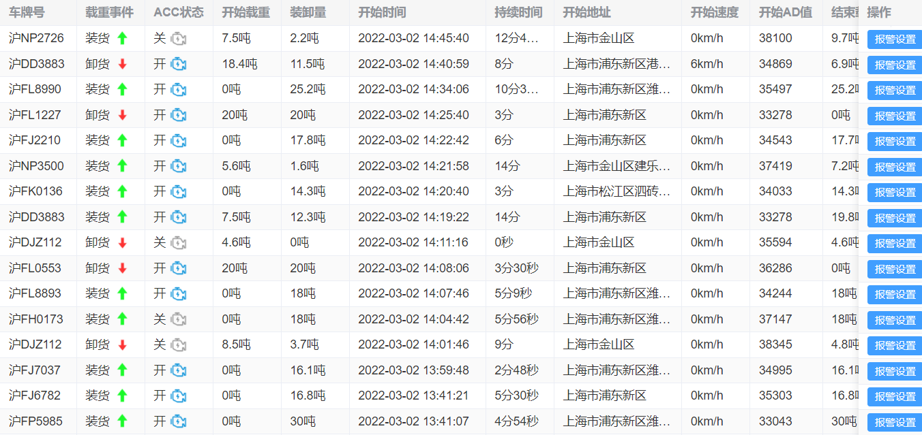
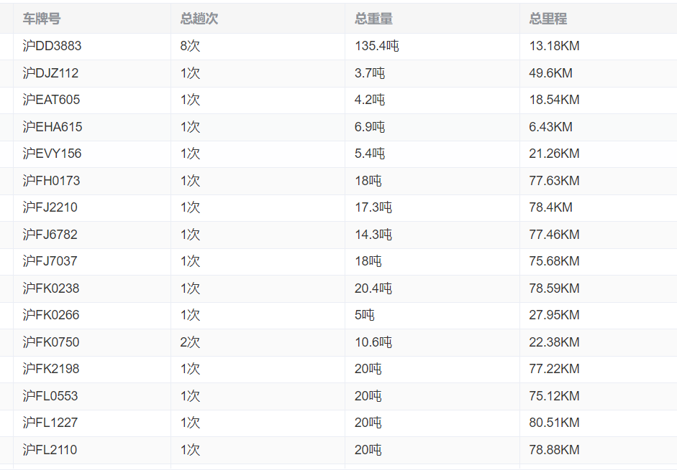
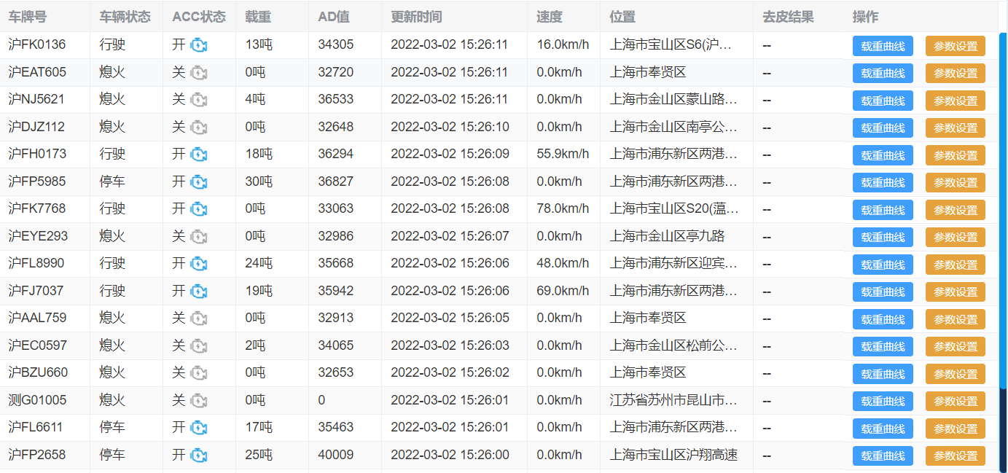
Intelligent load
CarEye platform is connected with load sensor, which can accurately calculate the weight, loading and unloading time, and can be widely used in logistics, sanitation and other industries. It is used for flow control, monitoring illegal unloading, and eliminating detour and stealing

Slide 12
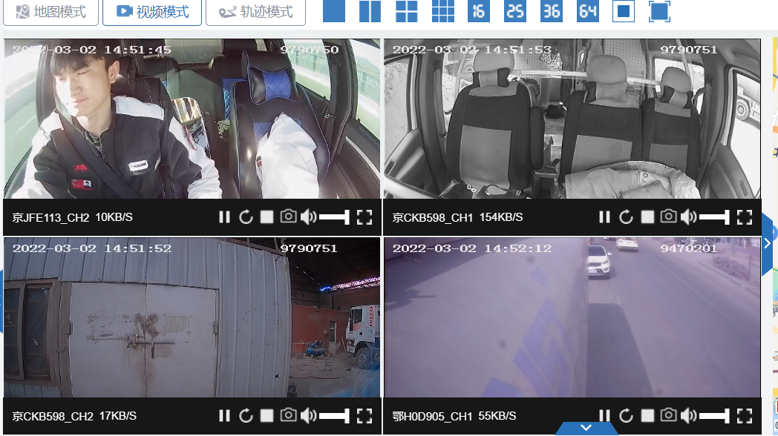
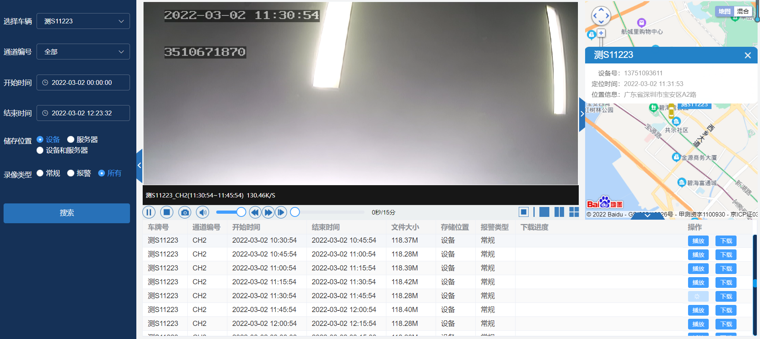
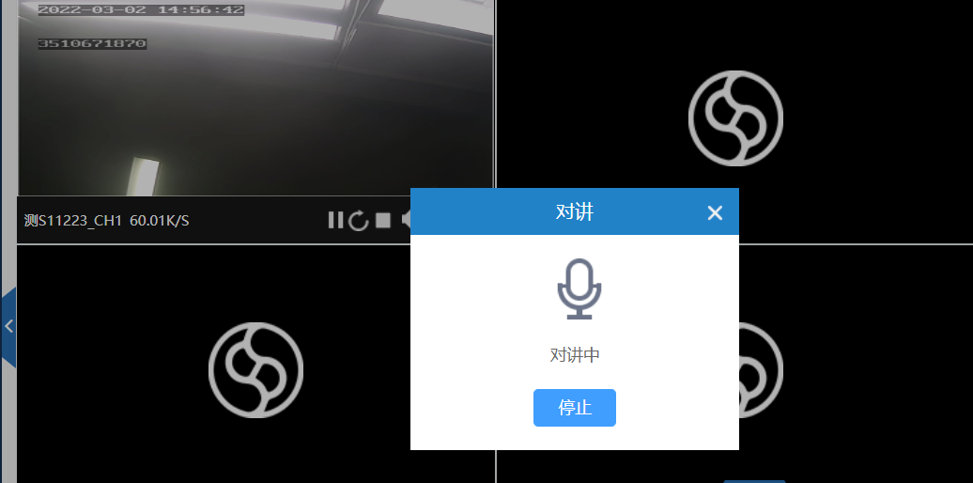
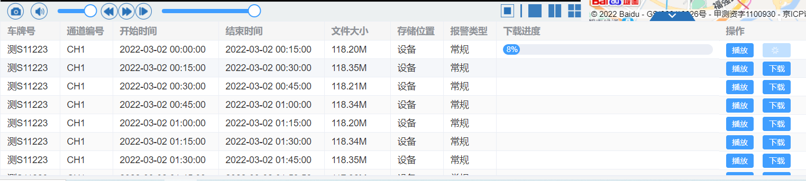
Vehicle vedio
real-time video
playback
Intercom
Remote video recording and download

Slide 13
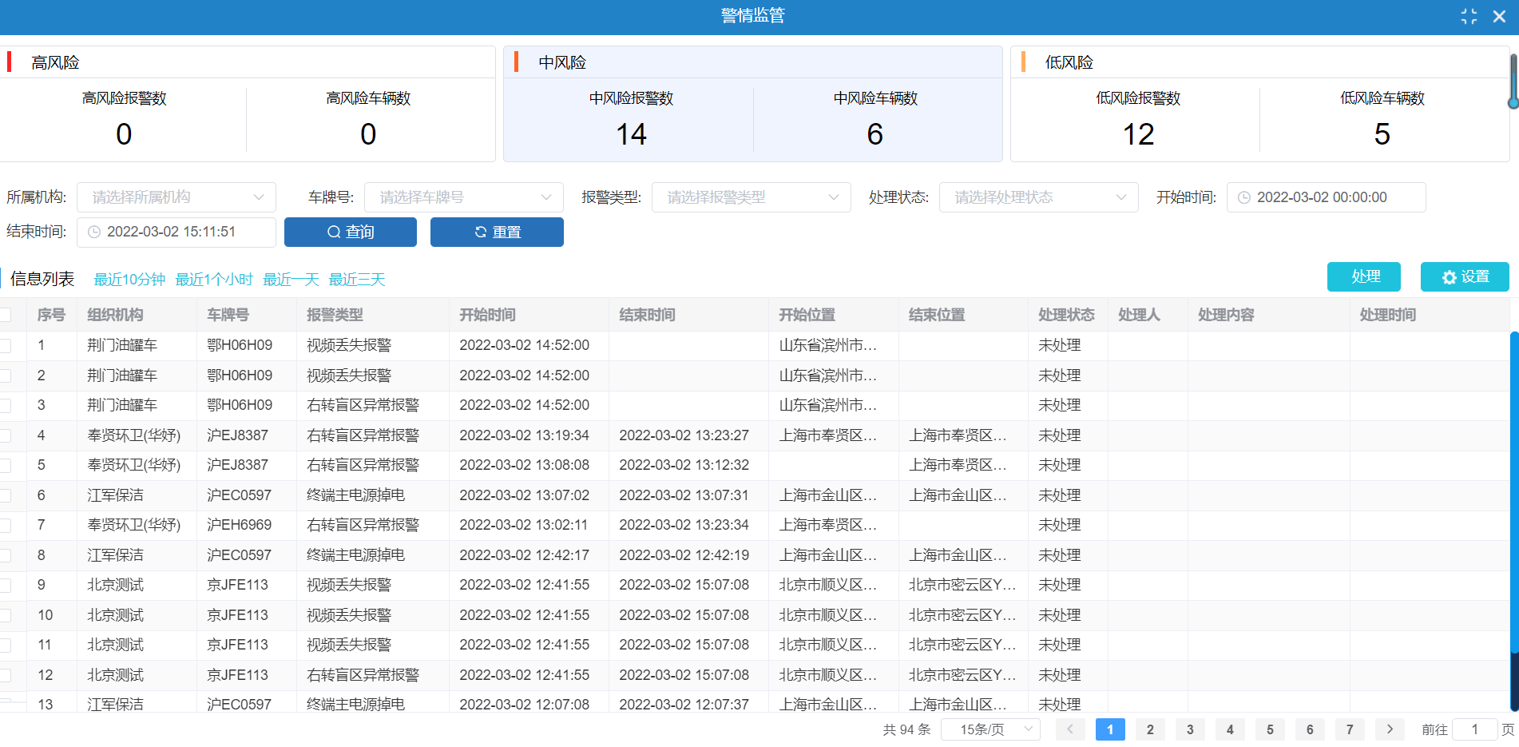
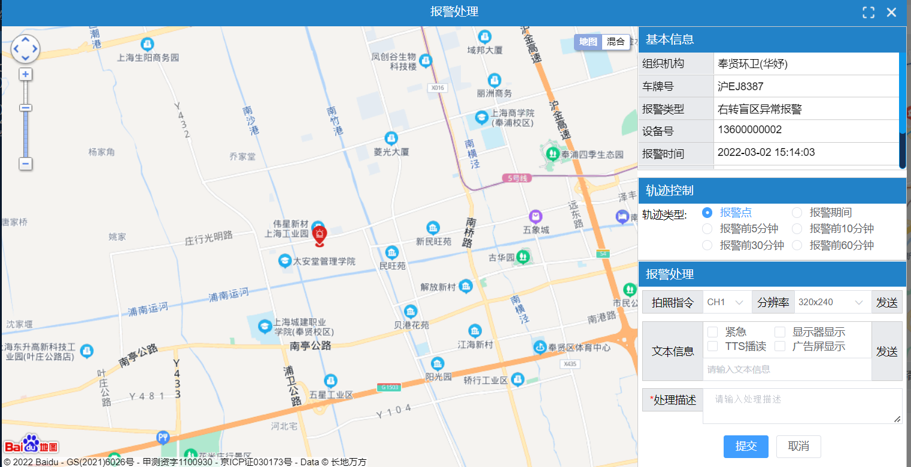
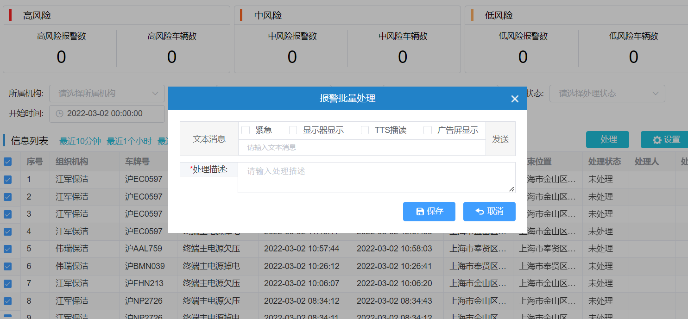
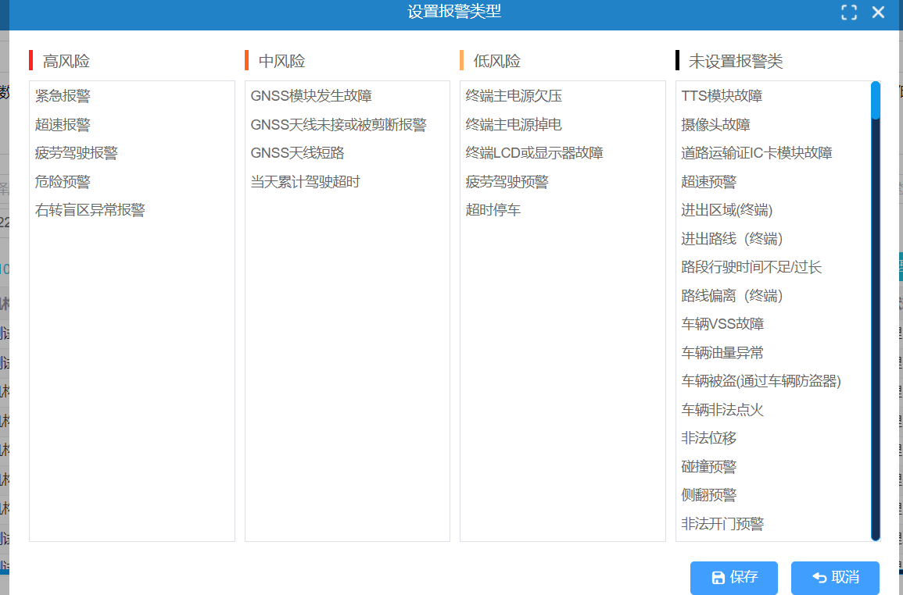
Alarm management
CarEye vehicle management platform monitors more than 100 alarm types to ensure timely notification and proper handling. It is convenient for managers to remotely analyze various problems during vehicle operation

Slide 14
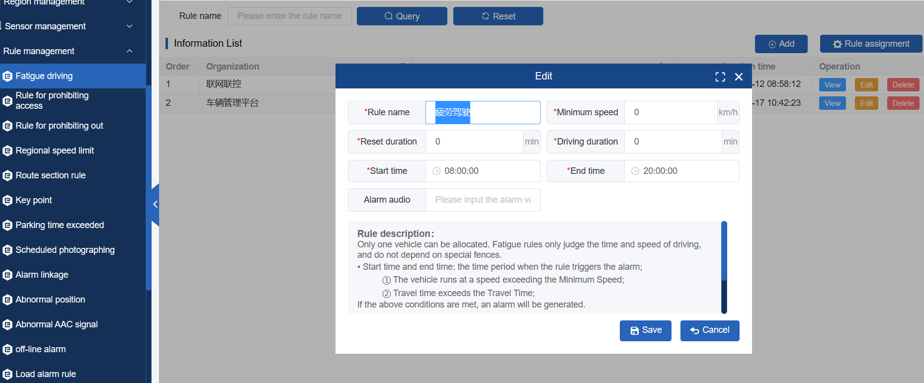
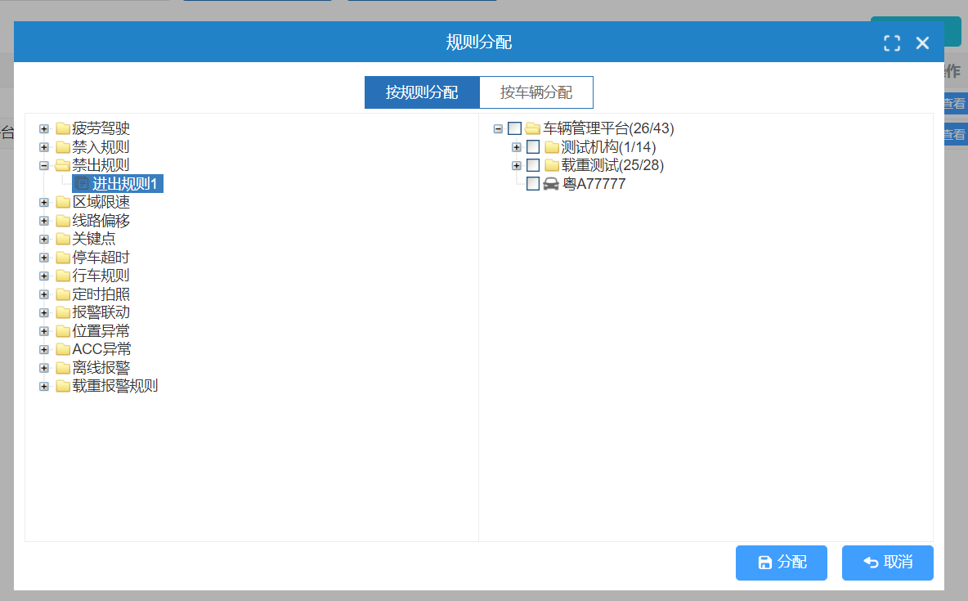
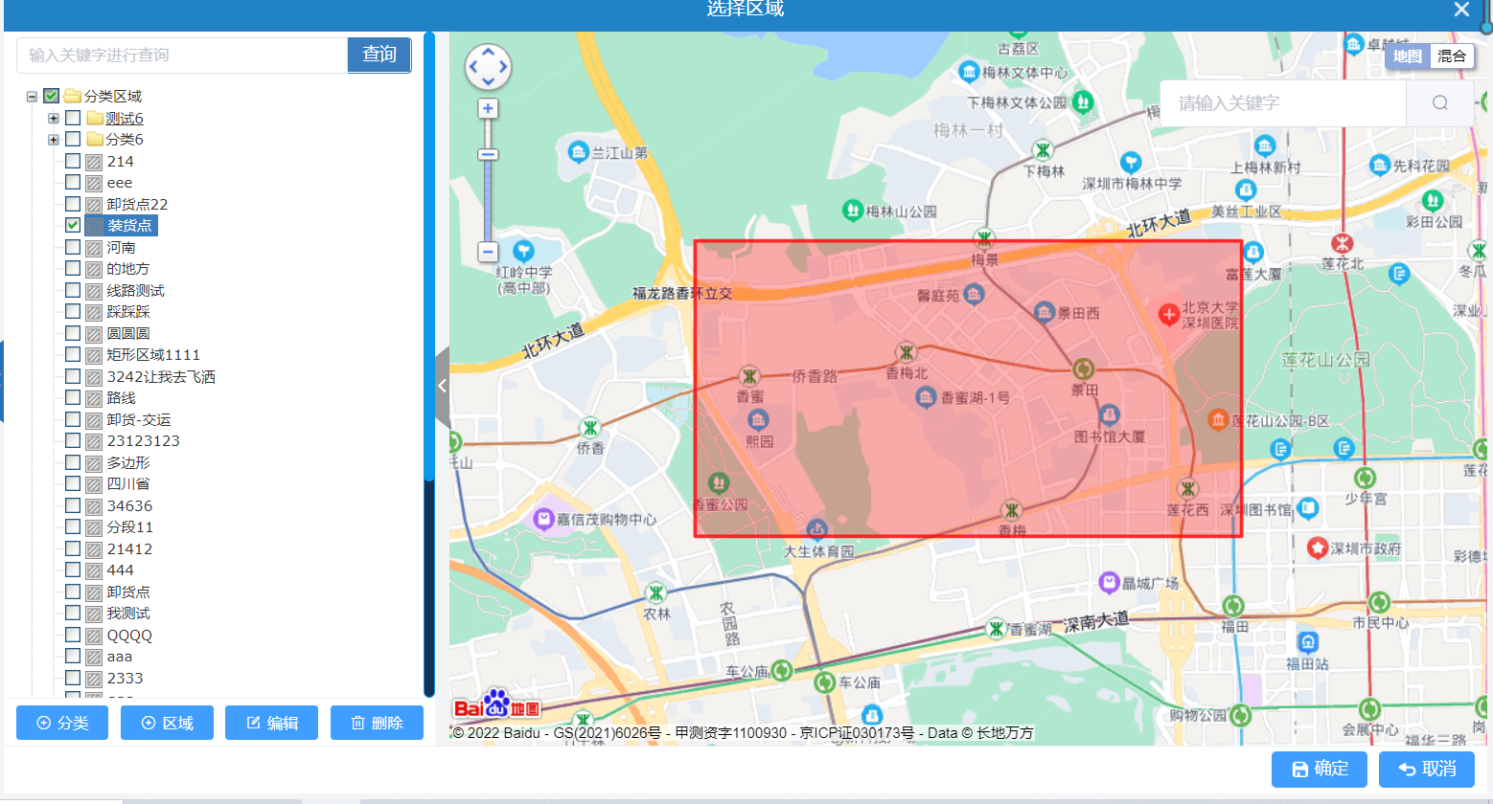
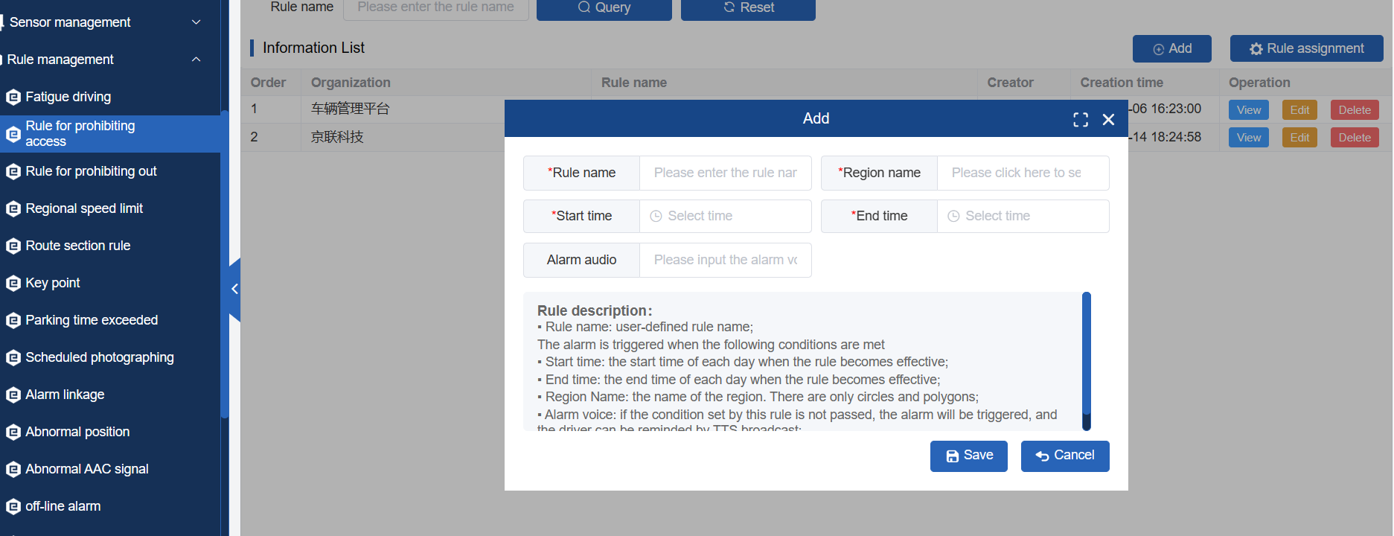
Rule management
CarEye vehicle management platform provides multiple platform alarm rules to meet the actual needs of the industry for setting fences, speeding, illegal driving, etc

Slide 15
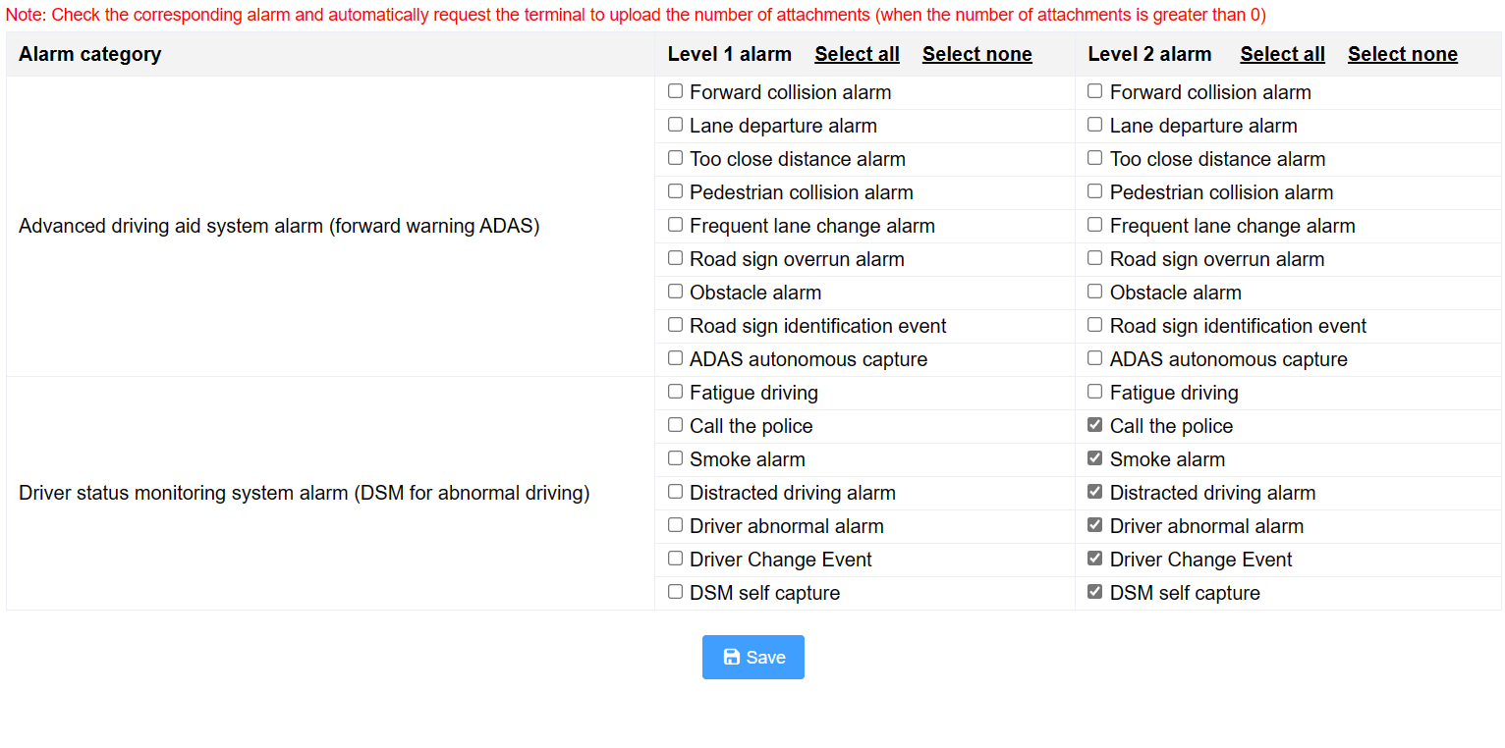
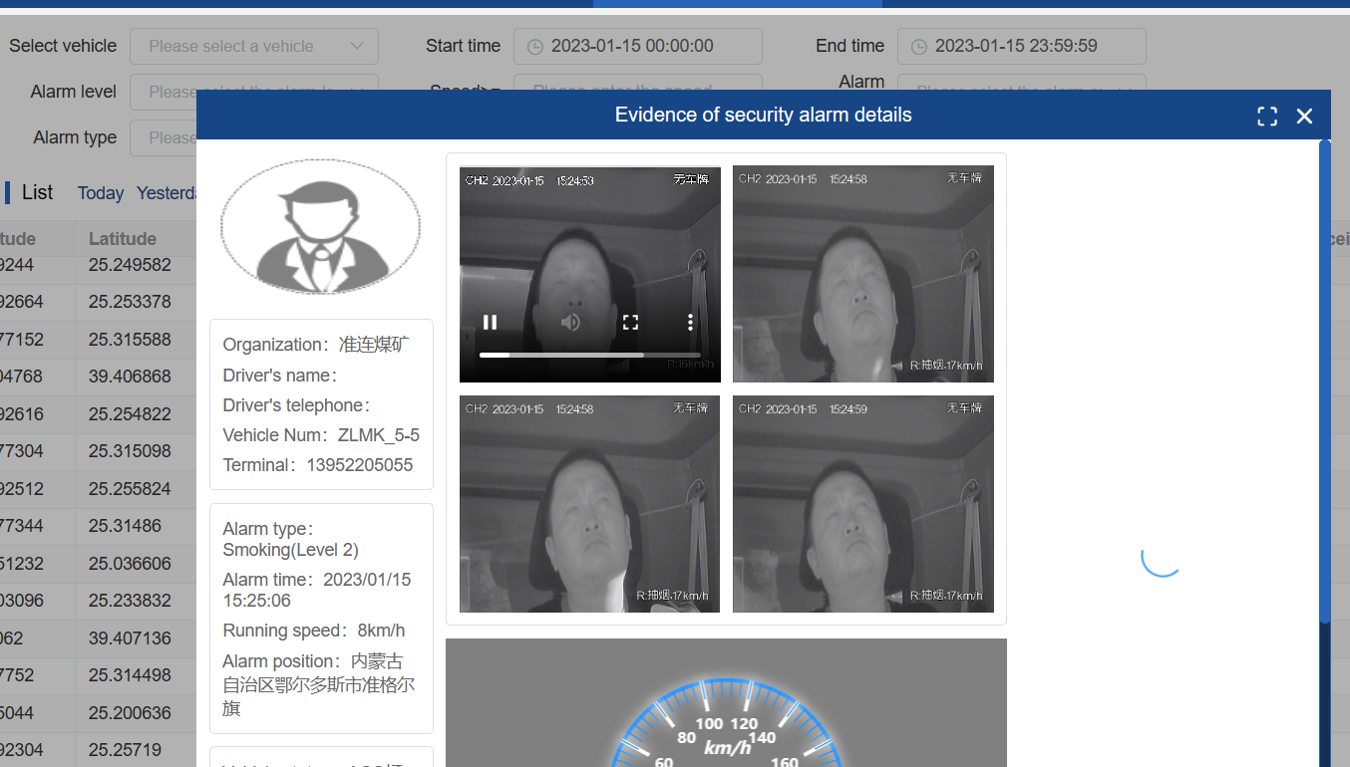
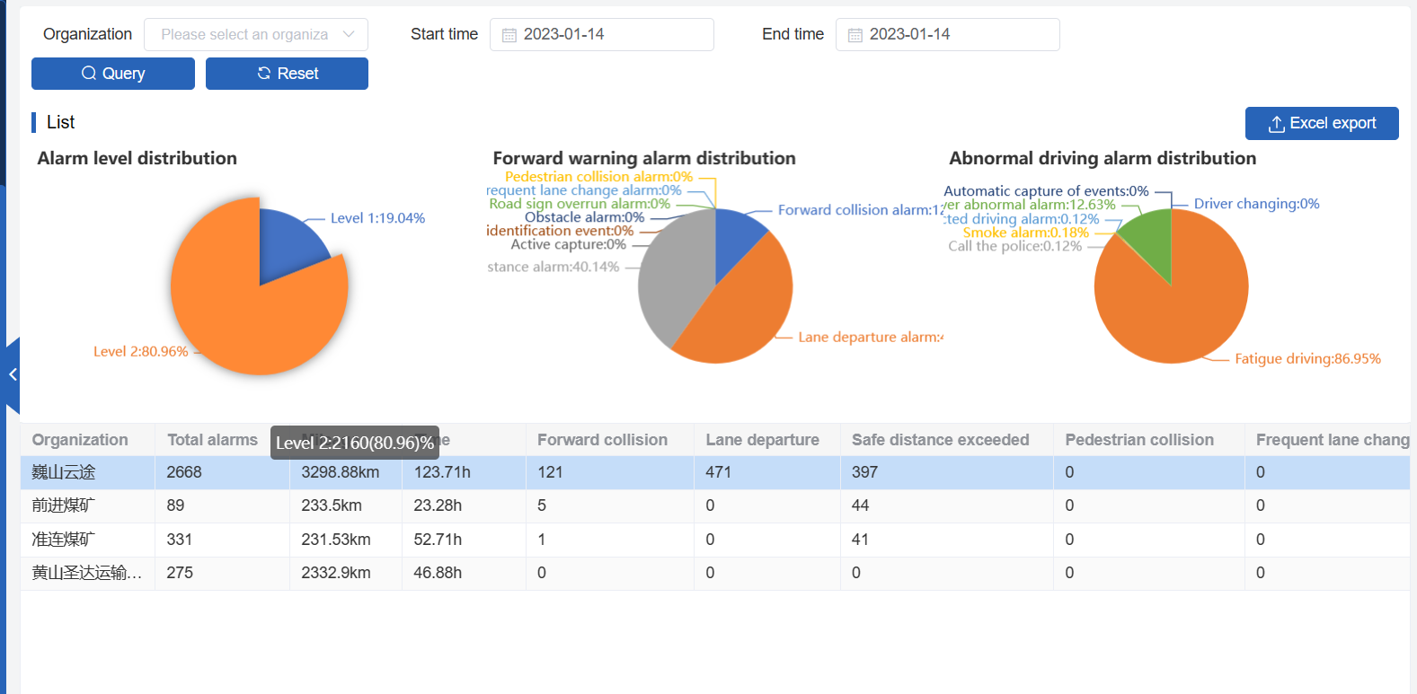
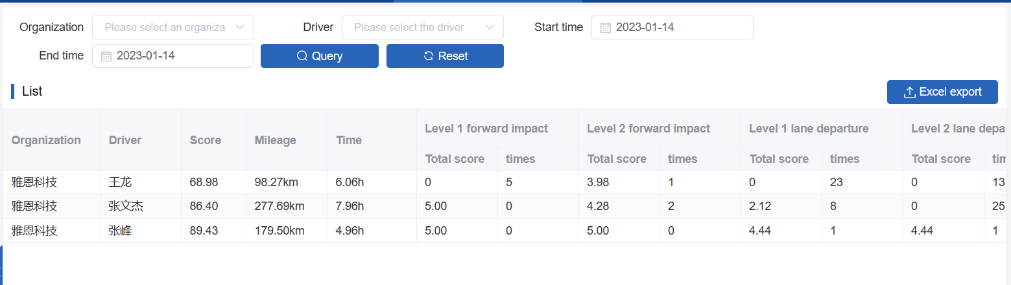
Security management
Meet the Soviet Union standard agreement, handle the ADAS and DSM alarms, monitor the driving behavior, and score the drivers

Slide 16
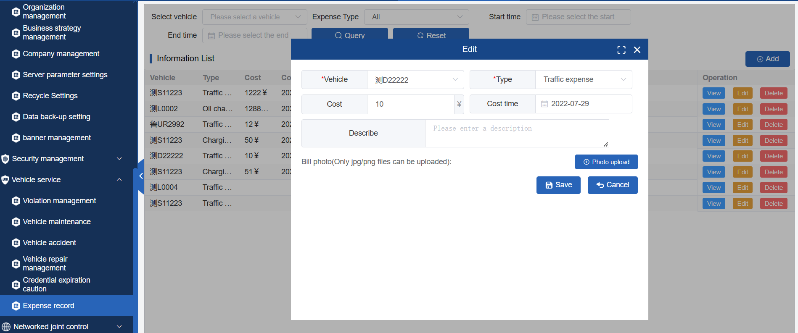
Vehicle operation guarantee
Input the accident, expense, maintenance and other information in the vehicle operation process into the platform, leave pictures and invoice information, and prevent the driver from making a disorderly reimbursement

Slide 17
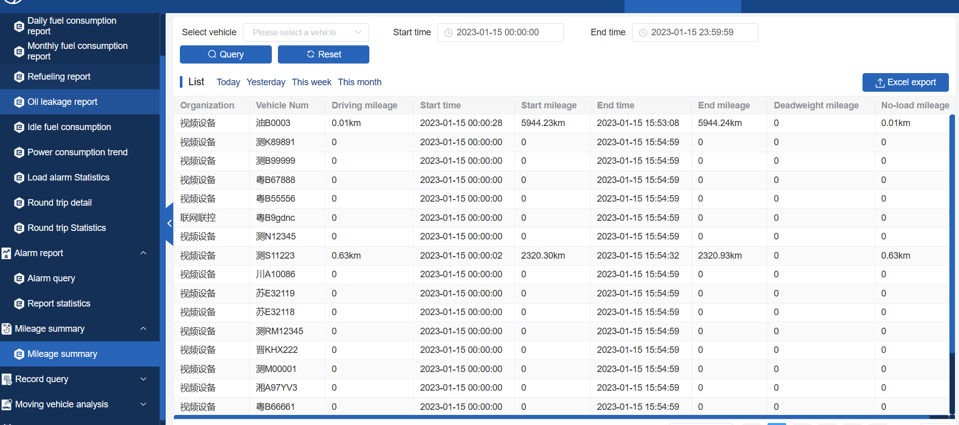
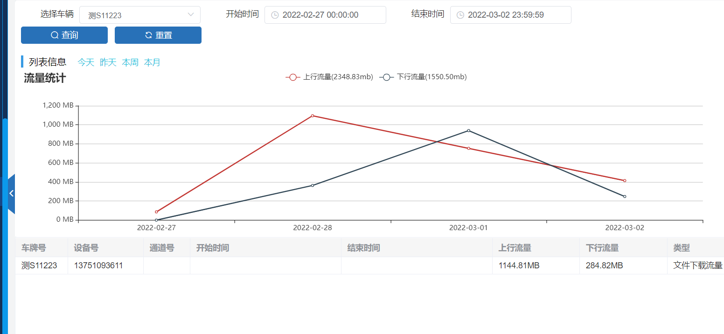
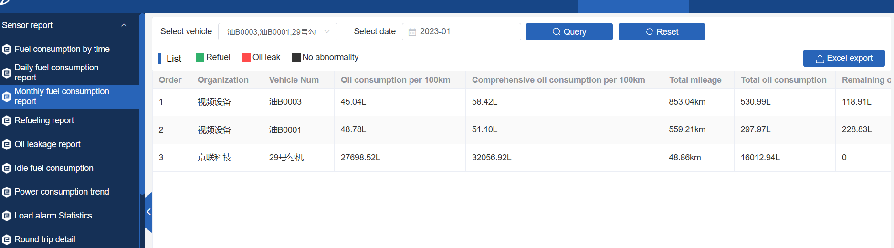
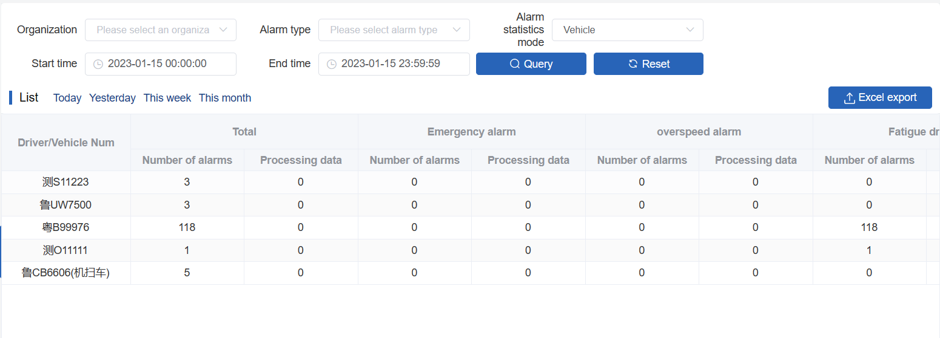
Statistical report

Slide 18
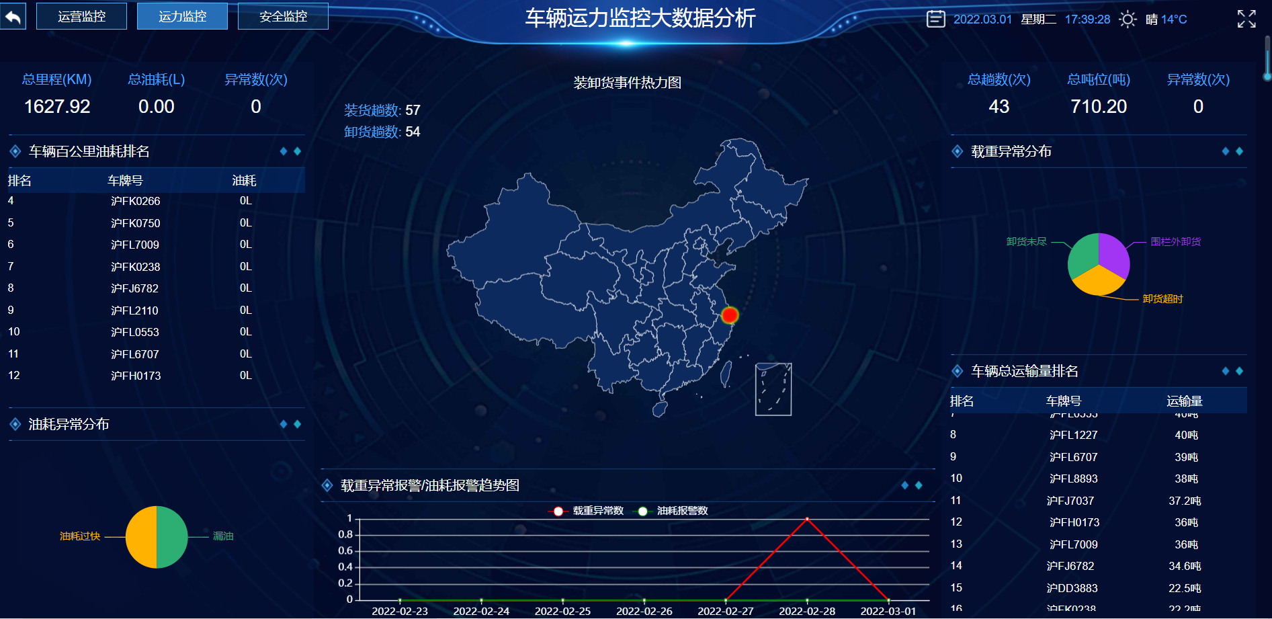
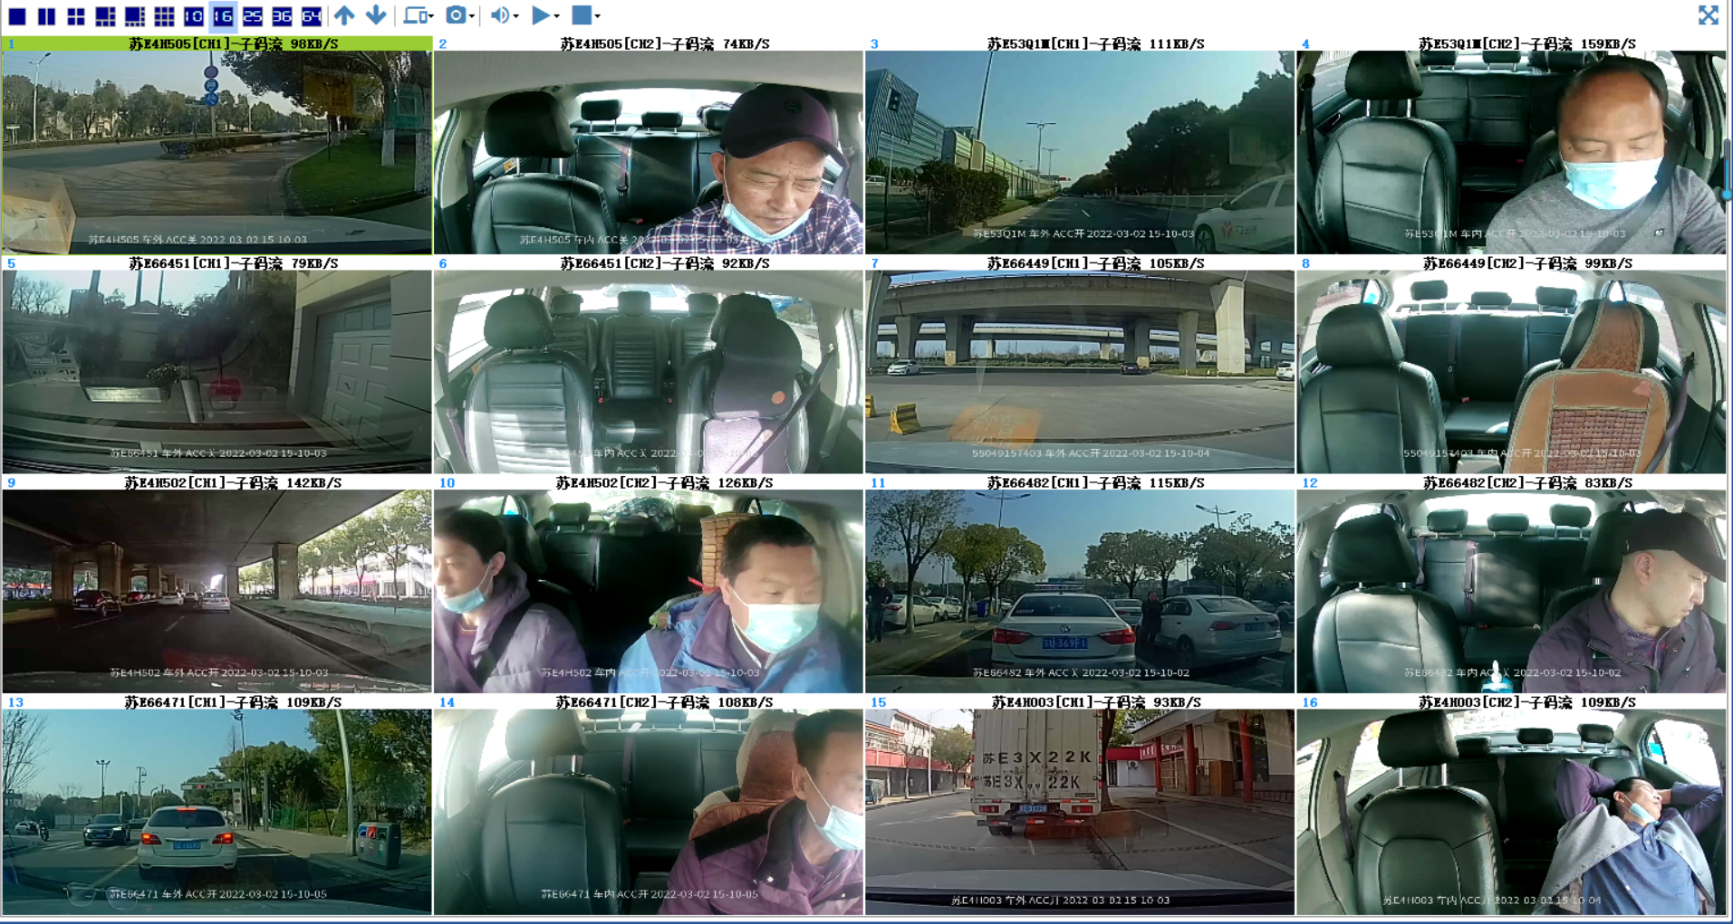
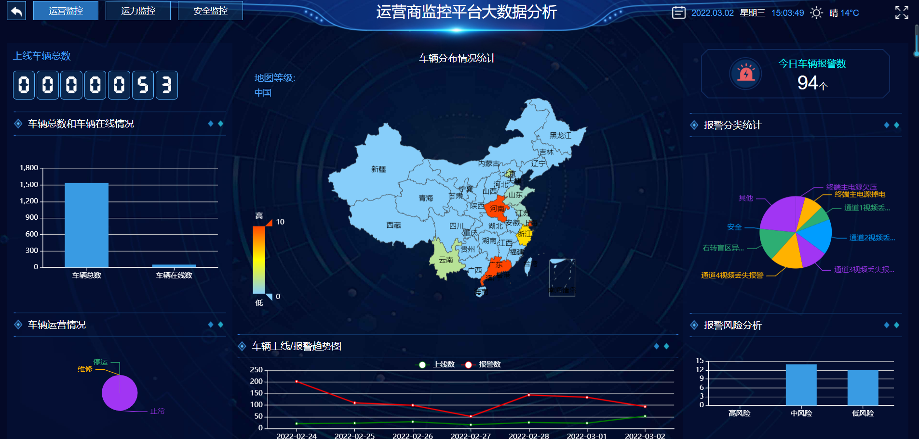
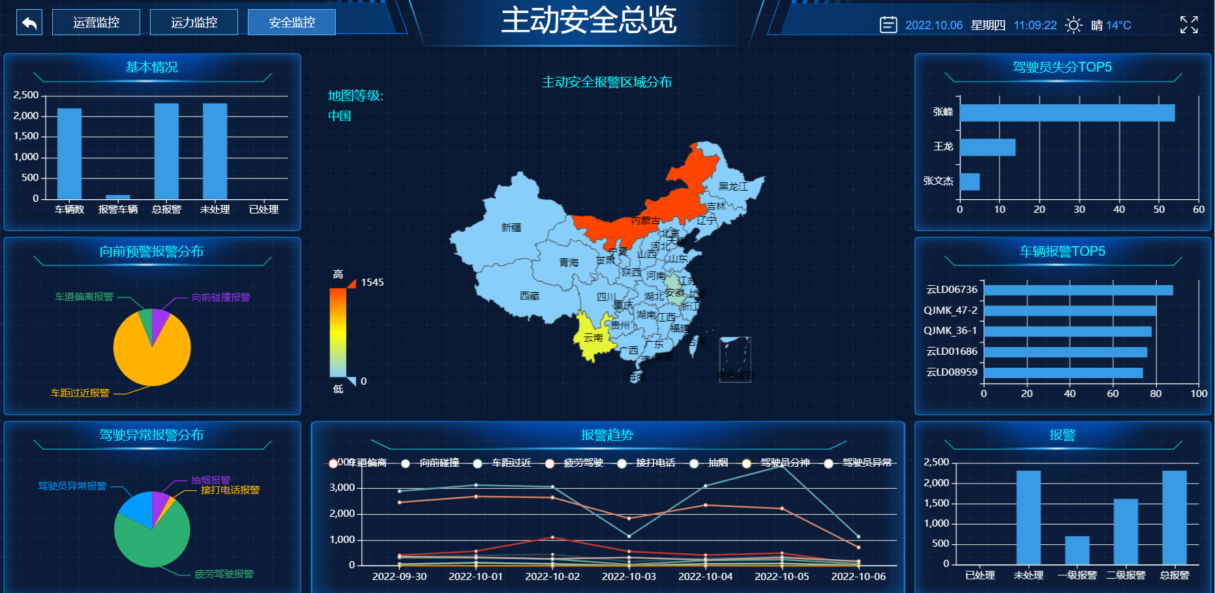
Monitoring screen

Slide 19
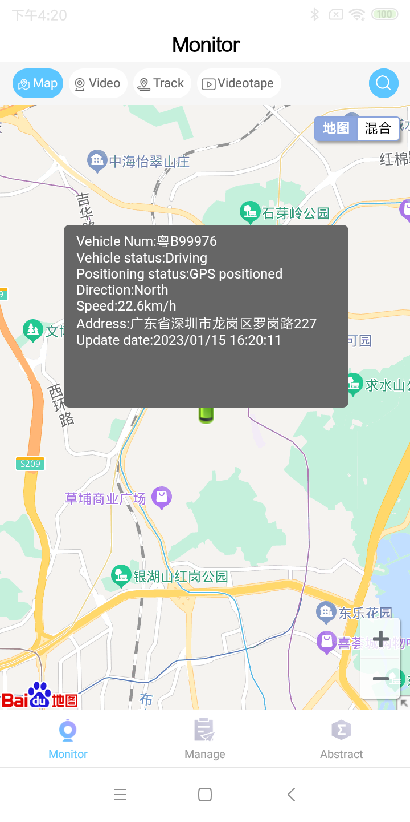
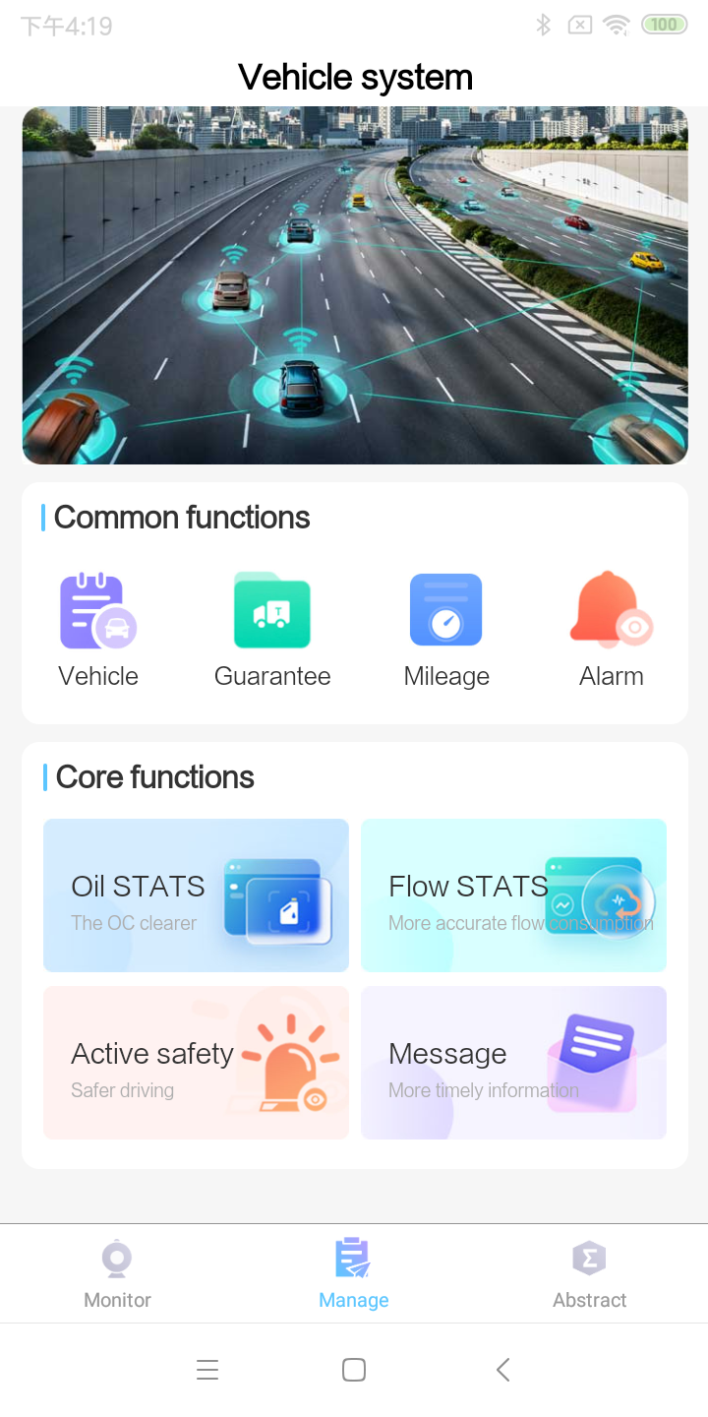
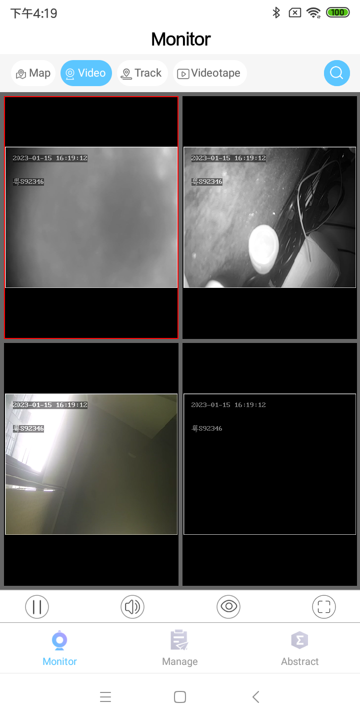
Mobile client

Slide 20
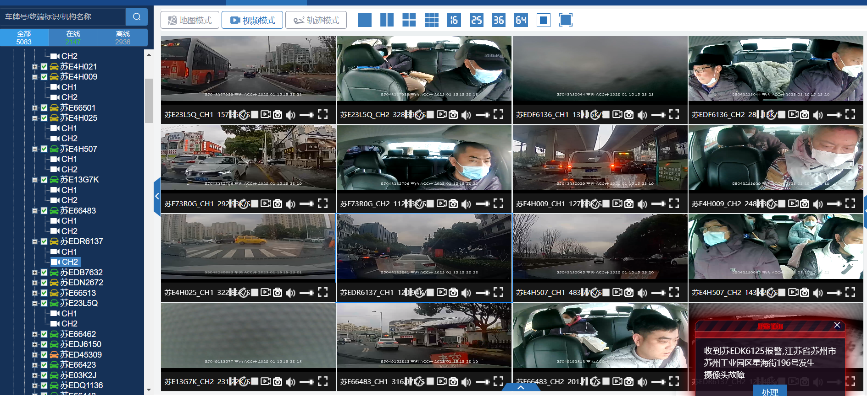
Case
Case 1：A taxi management platform in Suzhou
Adopt BS client management, friendly user interface and convenient operation

Slide 21
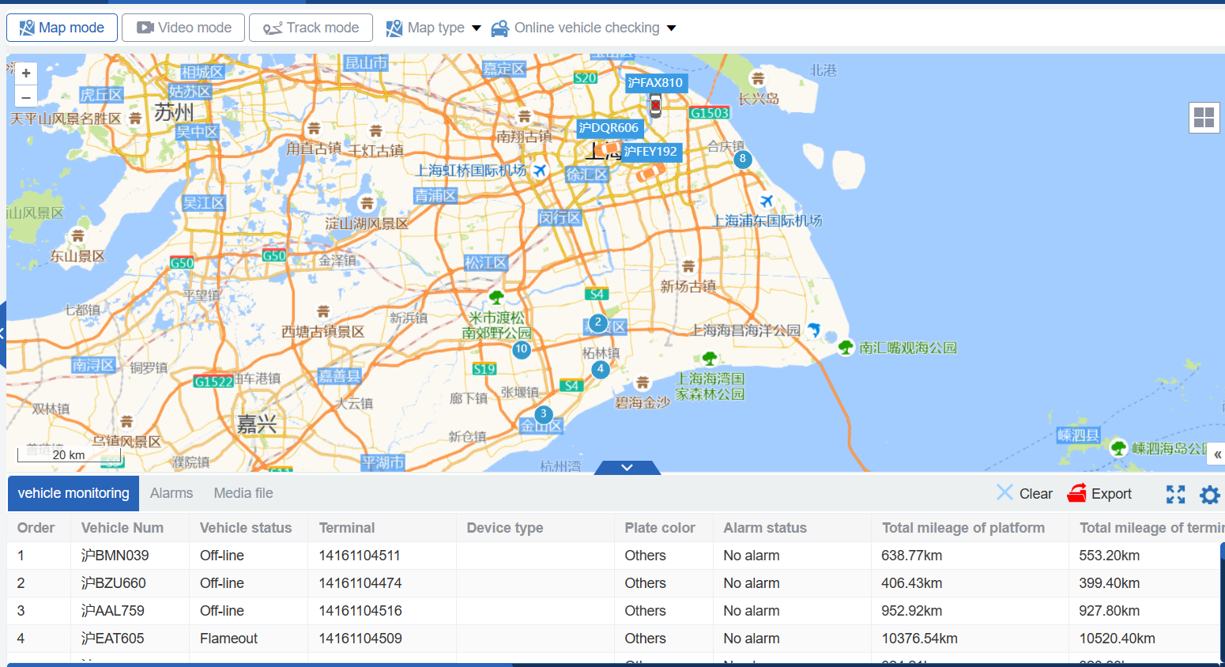
case 2：A sanitation vehicle management platform in Shanghai
Adopt high-precision load sensor to monitor the whole process of garbage collection and transportation

Slide 22

Build harmony and achieve win-win results
address：Room 106-2, Tower H, Bao'an Zhigu, No. 4, Yintian Road, Bao'an District, Shenzhen
phone：13510671870
contact：Deng
mail：support@car-eye.cn
website：www.car-eye.cn
Contact us

